Slide 1
Master Thesis Introduction Visual Analytics Framework for High Dimensional Data Streams
Khan Hafizur Rahman Supervisors
Matr-No 360142 Dr.Matthias Jarke, Dr.Christoph Quix
Hafizur.Rahman@rwth-aachen.de Arnab Chakrabarti

Slide 2
Topics I focussed:
Present Proposal
Requirement List, Architecture Diagram & Sequence Diagram of the framework
Implement The Graphical User Interface (GUI)
Implement “Add new file” and show files available

Slide 3
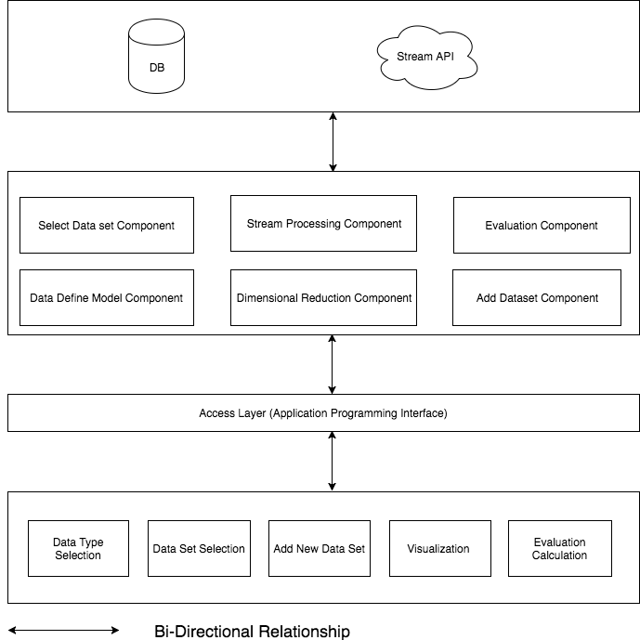
Framework Architecture

Slide 4
Next 2 week
Complete Stream Processing Component : Convert static data to stream data
Start implementing Dimensionality Reduction Algorithm

Slide 5
Thank you!

